Slide 1
Naïve Bayes Classifier

Slide 2
Naive Bayes classifiers are a collection of classification algorithms based on Bayes’ Theorem.
Consider a fictional dataset that describes the weather conditions for playing a game of golf. Given the weather conditions, each tuple classifies the conditions as fit(“Yes”) or unfit(“No”) for playing golf.

Slide 3
 | Outlook | Temperature | Humidity | Windy | Play Golf
0 | Rainy | Hot | High | False | No
1 | Rainy | Hot | High | True | No
2 | Overcast | Hot | High | False | Yes
3 | Sunny | Mild | High | False | Yes
4 | Sunny | Cool | Normal | False | Yes
5 | Sunny | Cool | Normal | True | No
6 | Overcast | Cool | Normal | True | Yes
7 | Rainy | Mild | High | False | No
8 | Rainy | Cool | Normal | False | Yes
9 | Sunny | Mild | Normal | False | Yes
10 | Rainy | Mild | Normal | True | Yes
11 | Overcast | Mild | High | True | Yes
12 | Overcast | Hot | Normal | False | Yes
13 | Sunny | Mild | High | True | No

Slide 4
The dataset is divided into two parts, namely, feature matrix and the response vector.
Feature matrix contains all the vectors(rows) of dataset in which each vector consists of the value of dependent features. In above dataset, features are ‘Outlook’, ‘Temperature’, ‘Humidity’ and ‘Windy’.
Response vector contains the value of class variable(prediction or output) for each row of feature matrix. In above dataset, the class variable name is ‘Play golf’.
The fundamental Naive Bayes assumption is that each feature makes an:
Independent, equal contribution to the outcome.
Notes:
With relation to our dataset, this concept can be understood as:
We assume that no pair of features are dependent. For example, the temperature being ‘Hot’ has nothing to do with the humidity or the outlook being ‘Rainy’ has no effect on the winds. Hence, the features are assumed to be independent.
Secondly, each feature is given the same weight(or importance). For example, knowing only temperature and humidity alone can’t predict the outcome accurately. None of the attributes is irrelevant and assumed to be contributing equally to the outcome.
all of these properties independently contribute to the probability that this fruit is an apple and that is why it is known as ‘Naive’.

Slide 5
Bayes’ Theorem finds the probability of an event occurring given the probability of another event that has already occurred. Bayes’ theorem is stated mathematically as the following equation:
P(A|B) = P(B|A) P(A)/ P(B)
where A and B are events and P(B) ≠ 0.
Basically, we are trying to find probability of event A, given the event B is true. Event B is also termed as evidence.
P(A) is the priori of A (the prior probability, i.e. Probability of event before evidence is seen). The evidence is an attribute value of an unknown instance(here, it is event B).
P(A|B) is a posteriori probability of B, i.e. probability of event after evidence is seen.

Slide 6
Now, with regards to our dataset, we can apply Bayes’ theorem in following way:
P(y|X) = P(X|y) P(y)/ P(X)
where, y is class variable and X is a dependent feature vector (of size n) where:
X = (x1,x2,x3,.....,xn)
Just to clear, an example of a feature vector and corresponding class variable can be: (refer 1st row of dataset)
X = (Rainy, Hot, High, False)
y = No

Slide 7
Now, its time to put a naive assumption to the Bayes’ theorem, which is, independence among the features.
So now, we split evidence into the independent parts.
Now, if any two events A and B are independent, then,
P(A/B) = P(A)P(B)

Slide 8
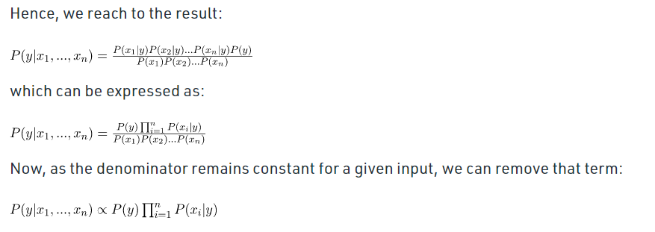


Slide 9
So, finally, we are left with the task of calculating P(y) and P(x_{i} | y).
Please note that P(y) is also called class probability and P(x_{i} | y) is called conditional probability.
The different naive Bayes classifiers differ mainly by the assumptions they make regarding the distribution of P(x_{i} | y).
Let us try to apply the above formula manually on our weather dataset. For this, we need to do some precomputations on our dataset.
We need to find P(x_{i} | y_{j}) for each x_{i} in X and y_{j} in y. All these calculations have been demonstrated in the tables below:

Slide 10
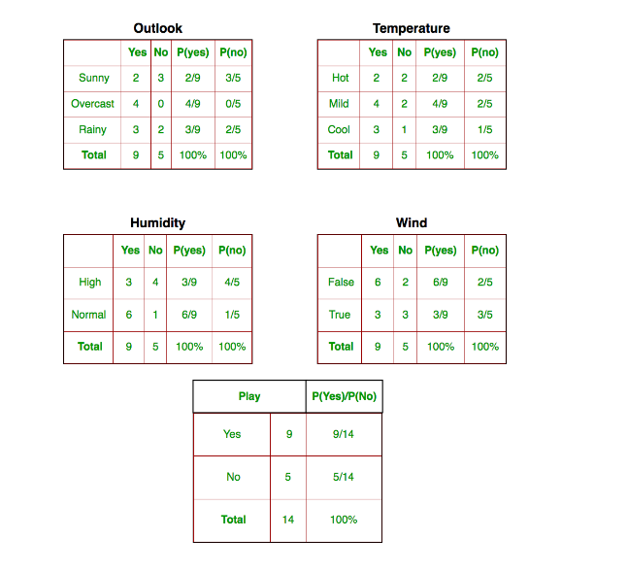

Slide 11
So, in the figure above, we have calculated P(x_{i} | y_{j}) for each x_{i} in X and y_{j} in y manually in the tables 1-4. For example, probability of playing golf given that the temperature is cool, i.e P(temp. = cool | play golf = Yes) = 3/9.
Also, we need to find class probabilities (P(y)) which has been calculated in the table 5. For example, P(play golf = Yes) = 9/14.
So now, we are done with our pre-computations and the classifier is ready!
Let us test it on a new set of features
today = (Sunny, Hot, Normal, False)

Slide 12
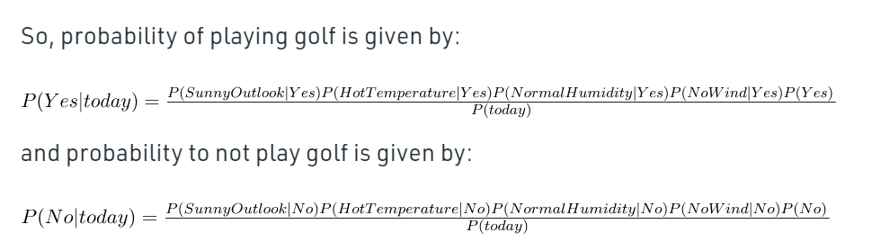

Slide 13
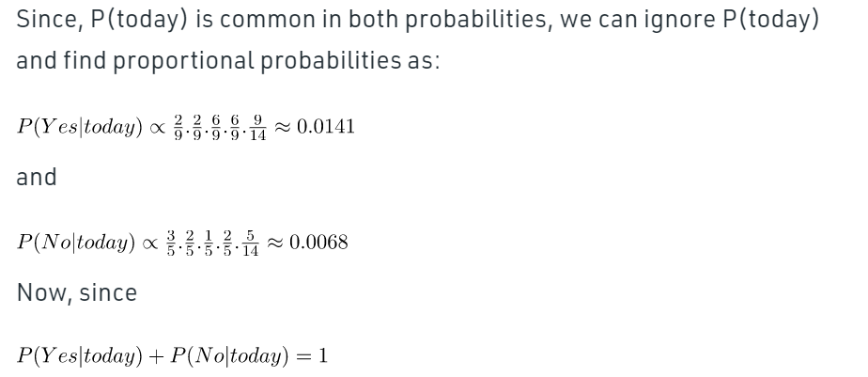

Slide 14
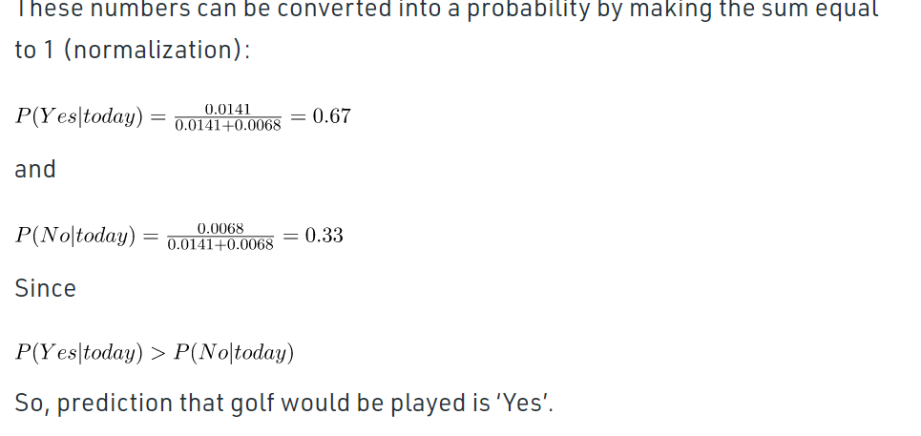
https://www.geeksforgeeks.org/naive-bayes-classifiers/

Slide 15
Naive Bayes classifier calculates the probability of an event in the following steps:
Step 1: Calculate the prior probability for given class labels
Step 2: Find Likelihood probability with each attribute for each class
Step 3: Put these value in Bayes Formula and calculate posterior probability.
Step 4: See which class has a higher probability, given the input belongs to the higher probability class.

Slide 16
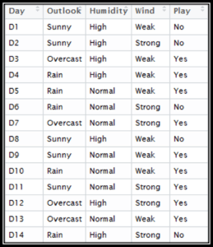

Slide 17
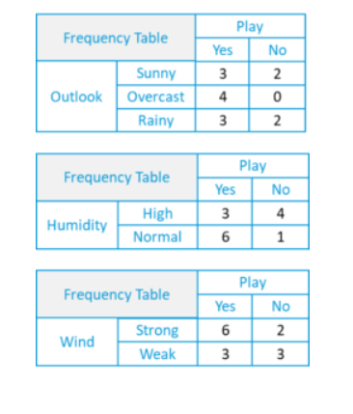

Slide 18
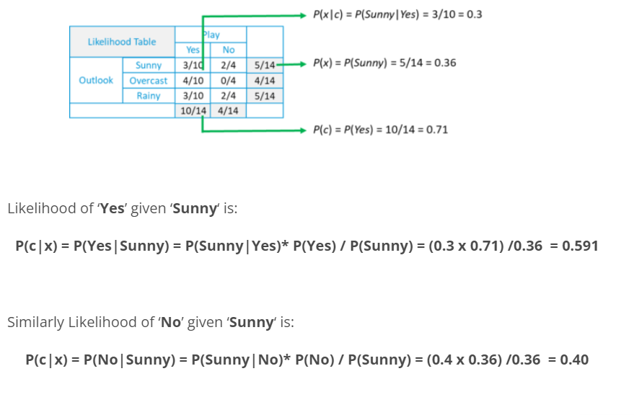

Slide 19
Code
# load the iris dataset
from sklearn.datasets import load_iris
iris = load_iris()
# store the feature matrix (X) and response vector (y)
X = iris.data
y = iris.target
# splitting X and y into training and testing sets
from sklearn.model_selection import train_test_split
X_train, X_test, y_train, y_test = train_test_split(X, y, test_size=0.4, random_state=1)
# training the model on training set
from sklearn.naive_bayes import GaussianNB
gnb = GaussianNB()
gnb.fit(X_train, y_train)
# making predictions on the testing set
y_pred = gnb.predict(X_test)
# comparing actual response values (y_test) with predicted response values (y_pred)
from sklearn import metrics
print("Gaussian Naive Bayes model accuracy(in %):", metrics.accuracy_score(y_test, y_pred)*100)

Slide 20
Output
Gaussian Naive Bayes model accuracy(in %): 95.0

Slide 21
Exercise
Use wine dataset from sklearn.datasets to classify wines into 3 categories. Load the dataset and split it into test and train. After that train the model using Gaussian and Multinominal classifier and post which model performs better. Use the trained model to perform some predictions on test data.

